Slide 1
Object-Oriented Analysis and Design
Inheritance, polymorphism, interfaces and more

Slide 2
Classes As Attributes
We’ve seen that UML allows us to notate a class containing another class as an attribute
This is general – doesn’t tell how Sale is instantiated
We saw composition and aggregation (closed and open diamonds) – does the containing class own the lifecycle of the contained class?

Slide 3
Code Example: Class as Attribute
class CoffeeCup {
private Coffee innerCoffee;
public void addCoffee(Coffee newCoffee) {
// no implementation yet
}
public Coffee releaseOneSip(int sipSize) {
// no implementation yet
// (need a return so it will compile)
return null;
}
public Coffee spillEntireContents() {
// no implementation yet
// (need a return so it will compile)
return null;
}
}
public class Coffee {
private int mlCoffee;
public void add(int amount) {
// No implementation yet
}
public int remove(int amount) {
// No implementation yet
// (return 0 so it will compile)
return 0;
}
public int removeAll() {
// No implementation yet
// (return 0 so it will compile)
return 0;
}
}

Slide 4
Code Example: Aggregation - Composition
public class WebServer {
private HttpListener listener;
private RequestProcessor processor;
public WebServer(HttpListener listener, RequestProcessor processor) {
this.listener = listener;
this.processor = processor;
}
}
- Aggregation: listener and processor are instantiated outside of the Webserver class
public class WebServer {
private HttpListener listener;
private RequestProcessor processor;
public WebServer() {
this.listener = new HttpListener(80);
this.processor = new RequestProcessor(“/www/root”);
}
}
- Composition: listener and processor are instantiated within the Webserver object

Slide 5
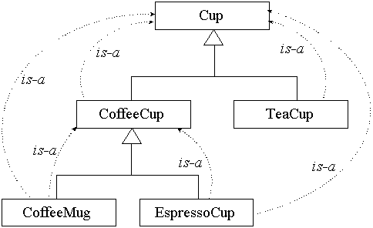
Abstract Classes and Inheritance
Aggregation and composition are “has-a” relationships: The Webserver “has-a” RequestProcessor
We use abstract classes and sub-classes for “is-a” relationships: The CoffeeCup “is-a” Cup
class Cup {
}
class CoffeeCup extends Cup {
}
class CoffeeMug extends CoffeeCup {
}

Slide 6
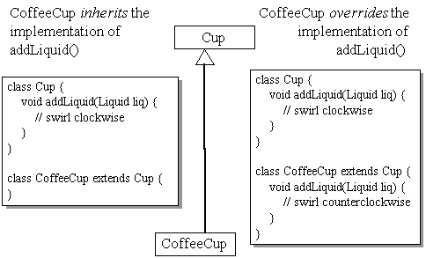
Sub-Classes and Inheritance
When a sub-class extends a super-class, it inherits the attributes and methods of the super-class
This means the sub-class will accept the same messages as the super-class
It also inherits the behavior of the methods
But it can overwrite the behavior and implement its own behavior in place of the super-class behavior
The sub-class may also add its own attributes and methods

Slide 7
Abstract Classes
An abstract class is a class that is never instantiated
It may have methods and attributes defined
The methods may also be abstract, which means that they have no implementation or default behavior
Sometimes super-classes are made abstract specifically because they contain methods that must be abstract
There is no reasonable default implementation for the method
abstract class Liquid {
abstract void swirl(boolean clockwise);
static void gurgle() {
System.out.println("All Liquid objects are gurgling.");
}
}

Slide 8
Inheritance and Order of Initialization
If attributes are initialized in a hierarchy of classes, Java will use a specific order: It initializes the high-order (super-classes) attributes first
This allows sub-classes to use the attributes (an possibly methods) of the super-class to initialize their own attributes
Note that constructors are not inherited
When a sub-class is instantiated, the JVM actually instantiates the super-class first, and then the sub-class (overwriting any attributes/methods the sub-class defines)
Thus, the sub-class has access to any of the super-class attributes/methods – they are inherited

Slide 9
Initialization and Inheritance
class Liquid {
private int mlVolume;
private float temperature; // in Celsius
public Liquid() {
mlVolume = 300;
temperature = (float) (Math.random() * 100.0);
}
public float getTemperature() {
return temperature;
}
// Has several other methods, not shown...
}
class Coffee extends Liquid {
private static final float BOILING_POINT = 100.0f; // Celsius
private boolean swirling;
private boolean clockwise;
public Coffee(boolean swirling, boolean clockwise) {
if (getTemperature() >= BOILING_POINT) {
// Leave swirling at default value: false
}else{
this.swirling = swirling;
}
if (swirling) {
this.clockwise = clockwise;
} // else, leave clockwise at default value: false
}
// Has several methods, not shown,
// but doesn't override getTemperature()...
}

Slide 10
Polymorphism
Applies to the super-class/sub-class hierarchy
Polymorphism is the ability to treat any subclass of a base class as if it were an instantiation of the base class
If your code needs to interact with a family of classes, you can write the code to send messages to (i.e. use the methods of) the base class
Even though your code thinks it is sending messages to the base class, it may in fact be sending messages to one of the sub-classes
This makes you code extensible – new subclasses may be added later, and you do not need to change your code; the existing code will work with the new sub-classes

Slide 11
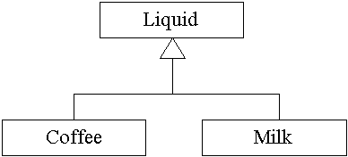
Polymorphism
To use an object of type liquid, you could declare a new liquid instance:
Liquid myFavoriteBeverage = new Liquid();
You can also assign a reference to any object that “is-a” liquid to variable of type liquid (a variable of the base type can hold a reference to an object derived from the base type):
Liquid myFavoriteBeverage = new Coffee();
// or...
Liquid myFavoriteBeverage = new Milk();

Slide 12
Polymorphism
To fully utilize polymorphism, we would like our code to send a message to an object even if we do not know the object’s class
You do this by invoking a method defined in the base type on an object referenced by a variable typed to the base type
This object could be the base class or a sub-class
You don’t know the actual class when you write or compile the code
You will need to declare the sub-class, but the main part of your code (that invokes the methods) can be unaware

Slide 13
Polymorphism
class Liquid {
void swirl(boolean clockwise) {
// Implement the default swirling behavior for liquids
System.out.println("Swirling Liquid");
}
}
class Coffee extends Liquid {
void swirl(boolean clockwise) {
// Simulate the peculiar swirling behavior exhibited
// by Coffee
System.out.println("Swirling Coffee");
}
}
class Milk extends Liquid {
void swirl(boolean clockwise) {
// Model milk's manner of swirling
System.out.println("Swirling Milk");
}
}

Slide 14
Polymorphism
class CoffeeCup {
private Liquid innerLiquid;
void addLiquid(Liquid liq) {
innerLiquid.add(liq);
// Swirl counterclockwise
innerLiquid.swirl(false);
}
}
Note that the CoffeeCup class can be used on any type of liquid, because it calls a method in the base class; this code does not change when new liquid sub-classes are created.
…
// First you need a coffee cup
CoffeeCup myCup = new CoffeeCup();
// Next you need various kinds of liquid
Liquid genericLiquid = new Liquid();
Coffee coffee = new Coffee();
Milk milk = new Milk();
// Now you can add the different liquids to the cup
myCup.addLiquid(genericLiquid);
myCup.addLiquid(coffee);
myCup.addLiquid(milk);

Slide 15
Polymorphism
Without polymorphism, we would need to do something like this ….
Note that every time a new liquid sub-class is added, we need to add a new else statement
Bad design!
In the correct design, CoffeCup simply invoked the method and let the object it was invoking the method on determine the behavior
UglyCoffeCup puts that knowledge of behavior in the wrong place – the object calling the method
class UglyCoffeeCup {
Liquid innerLiquid;
void addLiquid(Liquid liq) {
innerLiquid = liq;
if (liq instanceof Milk) {
((Milk) innerLiquid).swirlLikeMilk(false);
}
else if (liq instanceof Coffee) {
((Coffee) innerLiquid).swirlLikeCoffee(false);
}
else {
innerLiquid.swirlLikeGenericLiquid(false);
}
}
}

Slide 16
Extending Super-class
You can define new methods in a sub-class (these are specific to the sub-class, and are not overriding a method of the super-class)
However, you will need your base code to reference the sub-class directly (since the super-class is not aware of the new method)
class Liquid {
void swirl(boolean clockwise) {
System.out.println("Liquid Swirling");
}
}
class Tea extends Liquid {
void swirl(boolean clockwise) {
System.out.println("Tea Swirling");
}
void readFuture() {
System.out.println("Reading the future...");
}
}

Slide 17
Extending Super-class
// Create a Tea reference and a Tea object
Tea tea = new Tea();
// Ask the tea object to read the future of its drinker – this will work
tea.readFuture();
// Create a Liquid reference
Liquid liq = tea;
// Attempt to ask the same tea object to read the future
liq.readFuture(); // THIS WON'T COMPILE.

Slide 18
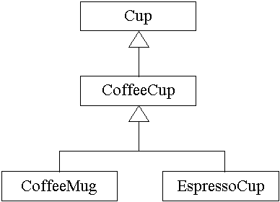
More on Polymorphism
Suppose we have another level of sub-class
We can again use polymorphism and define a method, say wash(), for each of the sub-classes and the super-class
Each sub-class can have its own implementation

Slide 19
More on Polymorphism
class Cup {
public void wash() {
System.out.println("Washing a Cup.");
// ...
}
//...
}
class CoffeeCup extends Cup {
public void wash() {
System.out.println("Washing a CoffeeCup.");
// ...
}
//...
}
class CoffeeMug extends CoffeeCup {
public void wash() {
System.out.println("Washing a CoffeeMug.");
// ...
}
//...
}
class EspressoCup extends CoffeeCup {
public void wash() {
System.out.println("Washing an EspressoCup.");
// ...
}
//...
}

Slide 20
More on Polymorphism
Again, we can use polymorphism: Suppose a class implemented a method that took a reference to Cup and applied the wash() method to it
We can pass this method a reference to any Cup object, or a reference to any sub-class of Cup object
The method does not know the exact class of the reference it is being passed, only that it implements the wash() method because it is a sub-class of Cup()
class VirtualCafe {
public static void prepareACup(Cup cup) {
//...
cup.wash();
//...
}
//...
}
….
Cup c = new Cup();
CoffeeCup cc = new CoffeeCup();
CoffeeMug cm = new CoffeeMug();
EspressoCup ec = new EspressoCup();
VirtualCafe.prepareACup(c);
VirtualCafe.prepareACup(cc);
VirtualCafe.prepareACup(cm);
VirtualCafe.prepareACup(ec);

Slide 21
More on Polymorphism
What if we wanted to extend the wash() concept to other classes what were not sub-classes of Cup, like a Car, Window or Dog?
We can’t use the above code, because the VirtualCafe method prepareACup expects to receive a Cup reference (or a reference to something that is a sub-class of Cup), and it does not really make sense to have Dog be a sub-class of Cup
We could just pass the prepareACup method a reference to a generic Object (we should probably change the name to prepareAnObject) and let the method figure out what kind of object it is using instanceOf, but this is bad design (like the if .. else code shown earlier)
We could declare a new super-class called WashableObject, have this new class declare the wash() method, and make Cup, Dog, Window, and Car sub-classes of it – but this is not very flexible and could lead to very complicated classes

Slide 22
Interfaces
What we really need is a way for different classes (which are not necessarily members of the same hierarchy) to share common methods
Java uses the interface for this – it has abstract methods, and may also contain attributes (that are considered final – they can’t be altered)
While a class can only extend one other class, it can implement multiple interfaces
You cannot instantiate an interface, but you can use it to type a reference to an object
To use these, we must give a definition for the interface, and then indicate that our class implements it

Slide 23
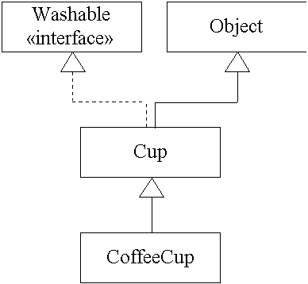
Interfaces
interface Washable {
int IMPERVIOUS = 0;
int RESISTENT = 1;
int FRAGILE = 2;
int EXPLOSIVE = 3;
/**
* returns true if the object needs to be washed
*/
boolean needsWashing();
/**
* washes the object
*/
void wash();
}

Slide 24
Interfaces
Since Cup implements Washable, it must implement all of the methods in the interface, or declare itself abstract
We can now define CoffeCup as a sub-class of Cup, and it can inherit or overwrite the wash() method just as before
class CoffeeCup extends Cup {
public void wash() {
System.out.println("Washing a CoffeeCup.");
//...
}
//...
}
class Cup extends Object implements Washable {
public int getLevelOfFragility() {
return Washable.FRAGILE;
}
public boolean needsWashing() {
// No implementation yet...
// hard-code a return value so it will compile
return true;
}
public void wash() {
System.out.println("Washing a Cup.");
//...
}
//...
}

Slide 25
Interfaces
Recall you cannot instantiate an interface object, but you can use it to type an object
class Example6a {
public static void main(String[] args) {
// OK to declare a variable as an interface type
Washable wa;
// Can't instantiate an interface by itself.
wa = new Washable(); // THIS WON'T COMPILE
Washable wa = new CoffeeCup(); // THIS WILL COMPILE
wa.wash(); // CAN USE THE METHOD DEFINED BY THE INTERFACE
}
}
Note that this means you do not need to know the details of CoffeCup, just that it implements Washable; you only need to know the details of Washable (which methods are declared in the interface)

Slide 26
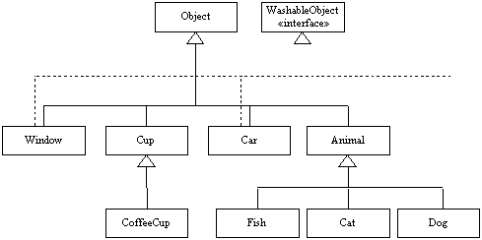
Interfaces
Let’s return to the previous example – we now have many classes and an interface definition
We can decide which super/sub-classes implement the interface – for example, we can have Cup (and hence all sub-classes) implement Washable, as well as Car and Window, but instead of Animal we can have only the Dog sub-class implement the interface
This gives us tremendous flexibility

Slide 27
Interfaces
Further, we can now design code that will work with any object that implements the interface, regardless of class type
This means we can add new classes or sub-classes, and still use the same code (Cleaner in this example)
Suppose that Dog extends Animal and implements Washable
We can declare an instance of Dog typed to Washable and pass it to the Cleaner method ….
class Cleaner {
public static void cleanAnObject(Washable washMe) {
//...
washMe.wash();
//...
}
}
…
Washable ourDog = new Dog();
ourCleaner = new Cleaner();
ourCleaner.cleanAnObject(ourDog);

Slide 28
Interfaces
It is possible for a class to implement multiple interfaces (but this may lead to a complicated class definition – more later)
Interfaces can be extended, just like abstract classes
There are many ways in which abstract classes and interfaces can be used to build a rich set of reusable objects
Most of this material was adapted from:
http://www.artima.com/objectsandjava/webuscript/CompoInherit1.html
http://www.artima.com/objectsandjava/webuscript/PolymorphismInterfaces1.html

